Slide 1
Scientific data set management: A lesson learned from building the Classical Language Toolkit
Kyle P. Johnson, PhD SF Python Meetup Group
kyle@kyle-p-johnson.com @Yelp
http://cltk.org February 10, 2016
Notes:
Why: I found that data scientists and digital humanists were failing w/ regards to replication; a host of problems

Slide 2
The CLTK’s goals …
Low: Good datasets for NLP of ancient languages (Egyptian hieroglyphs, Ancient Greek, Latin, Hebrew, Sanskrit, Tibetan, Classical Chinese, etc.)

Slide 3
The CLTK’s goals …
Low: Good datasets for NLP of ancient languages (Egyptian hieroglyphs, Ancient Greek, Latin, Hebrew, Sanskrit, Tibetan, Classical Chinese, etc.)
Medium: Quantified Classics

Slide 4
The CLTK’s goals …
Low: Good datasets for NLP of ancient languages (Egyptian hieroglyphs, Ancient Greek, Latin, Hebrew, Sanskrit, Tibetan, Classical Chinese, etc.)
Medium: Quantified Classics
High: Framework for an integrated study of the ancient world
Notes:
Most successful ancient language project on GitHub; many “firsts”

Slide 5
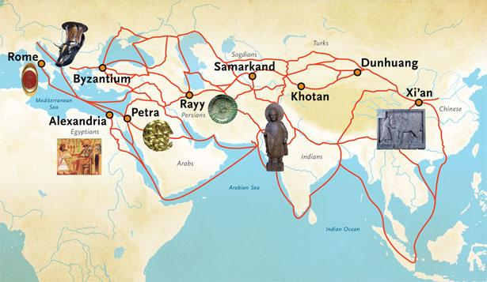
… a connected ancient world

Slide 6
Scientific method and communication
Make observations
Think of interesting questions
Formulate hypotheses
Develop testable predictions
Gather data to test predictions
Develop general theories
(repeat)

Slide 7
Scientific method and communication
Make observations
Think of interesting questions
Formulate hypotheses
Develop testable predictions
Gather data to test predictions
Develop general theories
(repeat)
Peer review
Documentation
Reproducibility
Archiving
Data sharing

Slide 8
Scientific method and communication
Make observations
Think of interesting questions
Formulate hypotheses
Develop testable predictions
Gather data to test predictions
Develop general theories
(repeat)
Peer review
Documentation
Reproducibility
Archiving
Data sharing
Notes:
I had problems both ways, using others and sharing mine In order to get repro, a corpus must have ..

Slide 9
Scientific method and communication
Make observations
Think of interesting questions
Formulate hypotheses
Develop testable predictions
Gather data to test predictions
Develop general theories
(repeat)
Peer review
Documentation
Reproducibility
Archiving
Data sharing
Data sets should be:
Versioned
Author-attributed
Auditable
Editable
Easily obtained
Notes:
I had problems both ways, using others and sharing mine

Slide 10
Problem: Data set realities
Storage problems
Obscure university websites
Unreliable personal websites
Disappearing old versions
Buried in source code
USB drive, CD
Format problems
Obfuscating compression
Ugly file organization
Fetching problems
Bad protocols for large files
Unfriendly protocols

Slide 11
Problem: Data set realities
┐(´д`)┌
Storage problems
Obscure university websites
Unreliable personal websites
Disappearing old versions
Buried in source code
USB drive, CD
Format problems
Obfuscating compression
Ugly file organization
Fetching problems
Bad protocols for large files
Unfriendly protocols

Slide 12
Solution: Git-backed corpus management
Git is:
✓ Versioned
✓ Author-attributed
✓ Auditable
✓ Editable
? Easily obtained
Notes:
The second column’s check marks are for other desirables in the bad data set possibilities

Slide 13
Solution: Git-backed corpus management
Git is:
✓ Versioned
✓ Author-attributed
✓ Auditable
✓ Editable
? Easily obtained
and also:
Distributed
Non-linear
✓ Collaborative
Scales
✓ fsck
✓ Compressed
Diff updates
Merge strategies
Easy updates to end users
Notes:
The second column’s check marks are for other desirables in the bad data set possibilities

Slide 14
Solution: Git-backed corpus management
Git is:
✓ Versioned
✓ Author-attributed
✓ Auditable
✓ Editable
? Easily obtained
and also:
Distributed
Non-linear
✓ Collaborative
Scales
✓ fsck
✓ Compressed
Diff updates
Merge strategies
Easy updates to end users
GitHub adds:
✓ Easily obtained
✓ High availability
✓ Community oriented
Notes:
The second column’s check marks are for other desirables in the bad data set possibilities

Slide 15
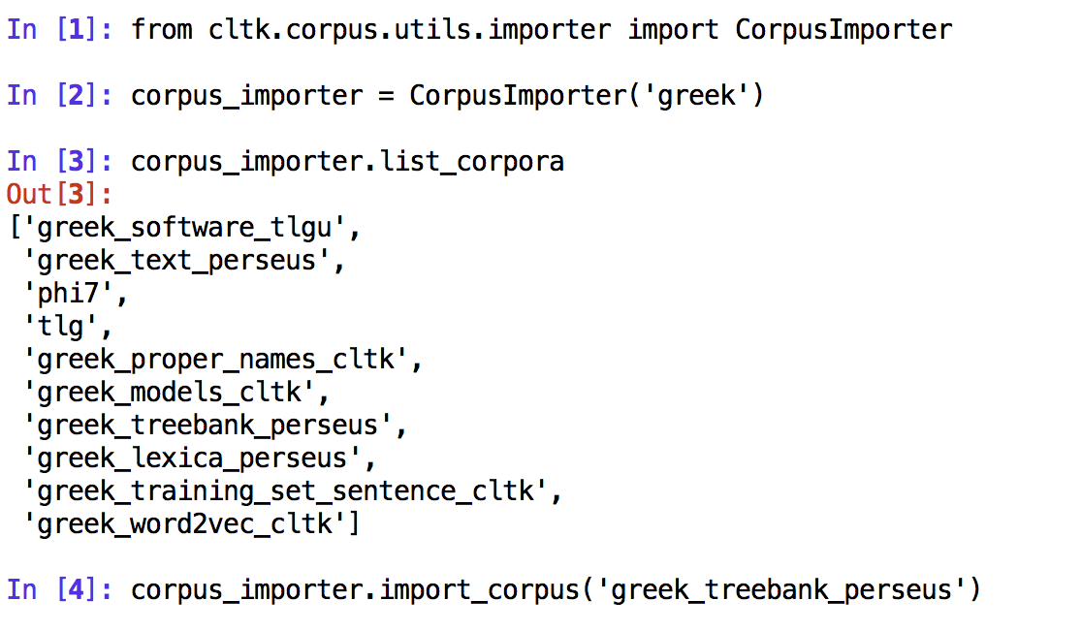
Example of corpus import

Slide 16
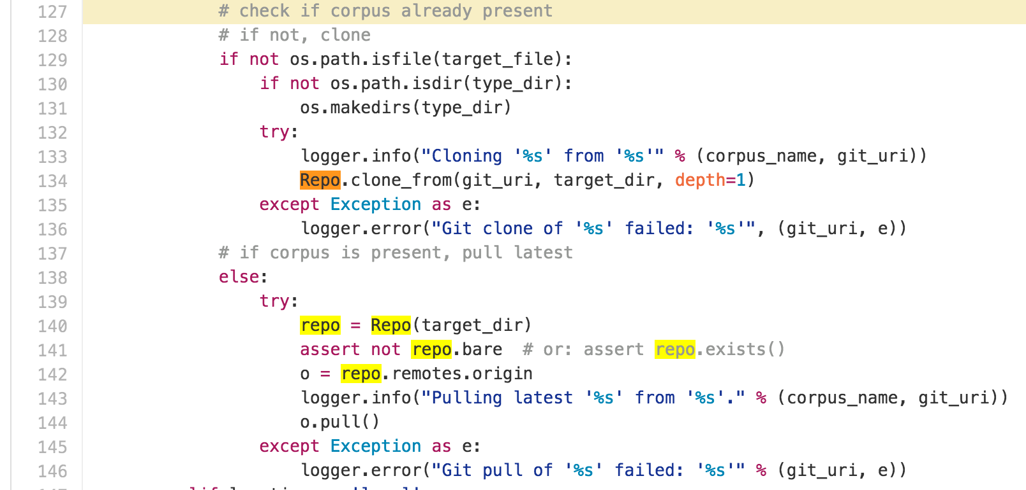
Source code snippet

Slide 17
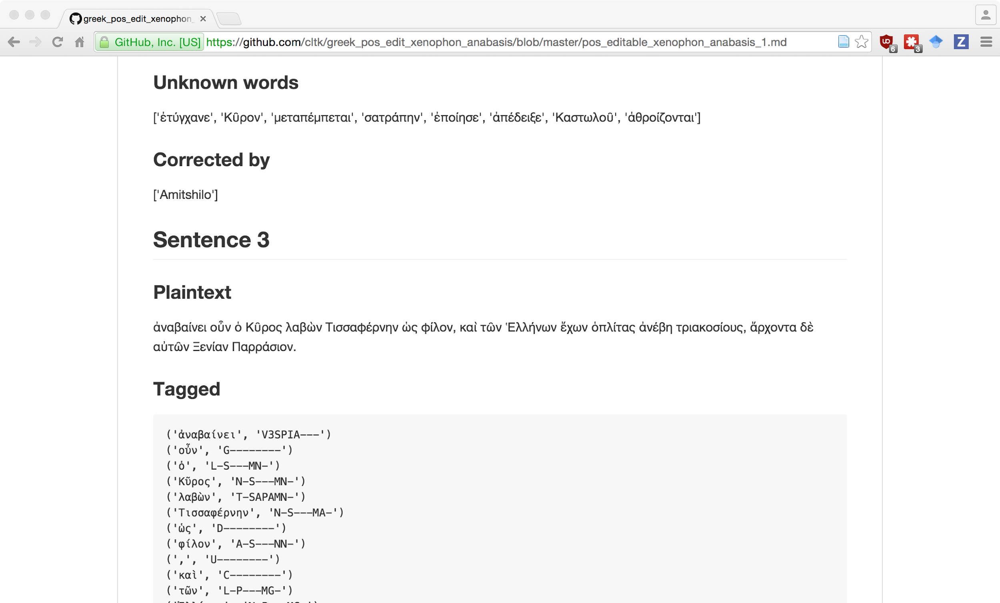
Example of online annotations

Slide 18
Contribute & contact
Classical Language Toolkit
Home: http://cltk.org/
Docs: http://docs.cltk.org/en/latest/
Source: https://github.com/cltk/cltk
Corpora: https://github.com/cltk
Import module: https://github.com/cltk/cltk/blob/master/cltk/corpus/utils/importer.py
Contribute
Issue tracking: https://github.com/cltk/cltk/issues
Other questions: kyle@kyle-p-johnson.com

Slide 19
Sources
Images
http://www.penn.museum/silkroad/exhibit_silkroad.php
Git
GitPython: https://github.com/gitpython-developers/GitPython
https://en.wikipedia.org/wiki/Git_(software)
Science
https://en.wikipedia.org/wiki/Scientific_method
https://en.wikipedia.org/wiki/Reproducibility

